Slide 1





15446 Bel Red Road, Suite 201
Redmond, WA 98052
Extended Training Program
June 29, 2016

Slide 2
Agenda
Training Plan
Module details
Training Outcome
Expectations from Participants

Slide 3
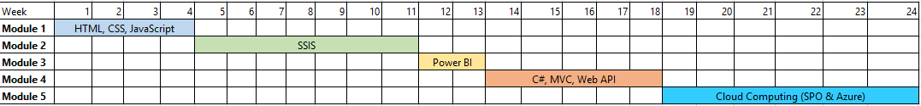
Training Plan

Slide 4
Training Outcome
Module | Expected Output
HTML/CSS/JS | Complete AngularJS course on Code Academy Complete jQuery course on Try.jQuery Complete Responsive Web Apps Course Create course on NodeCasts.io
SSIS | 70-461 Microsoft Certification (Querying Microsoft SQL Server 2012) 70-463 Microsoft Certification (Implementing a Data Warehouse with Microsoft SQL Server 2012)
Power BI (Dat207x) | EDX Course Completion
C# | Udemy Course completion MVA Course Completion 70-487 Course Completion
SPO + Cloud Computing | 70-533 Microsoft certification (Implementing Microsoft Azure Infrastructure Solutions)
Note:
All Microsoft certifications will be reimbursed by organization.
For other certifications, it is mandatory to complete all modules and you have an option to claim paid certificate. However it will not be reimbursed by organization
Attached Excel for detailed topics

Slide 5
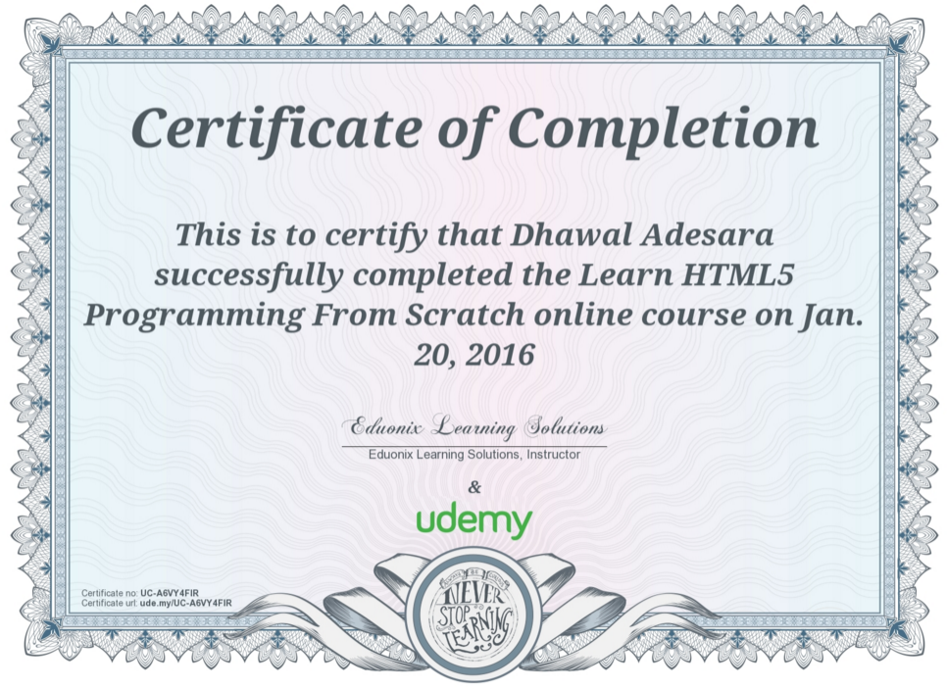
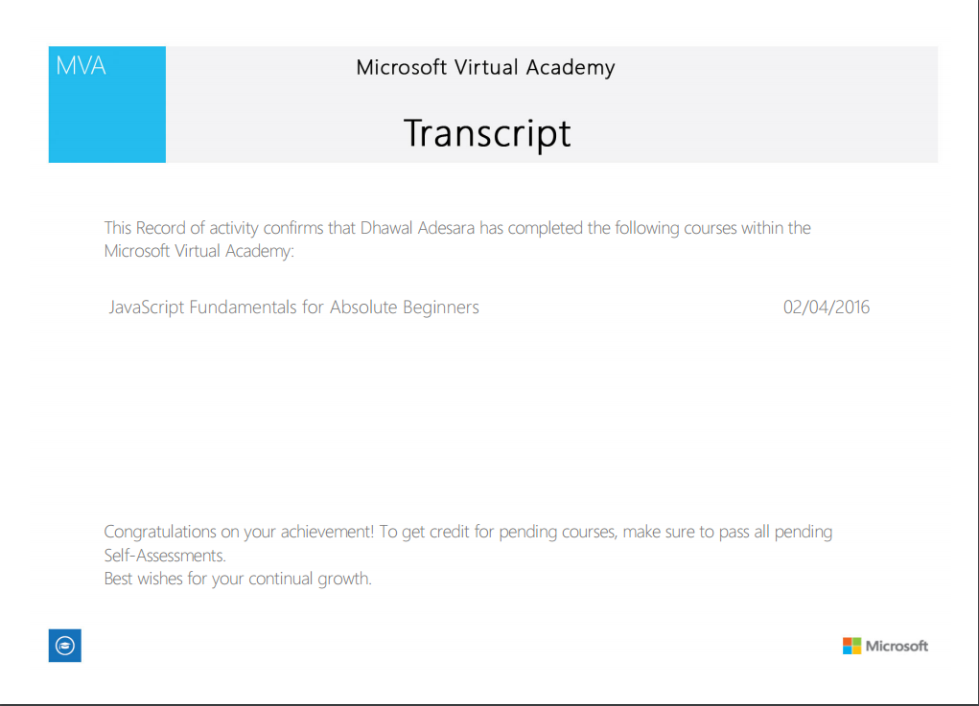
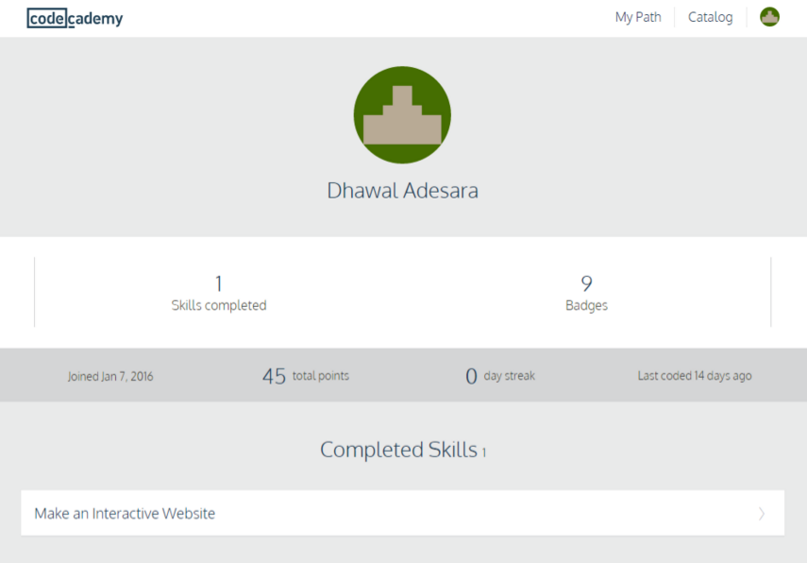
Training Outcome – Sample Certificates

Slide 6
Expectations from Participants
Q. Is attendance mandatory for Extended Training Program?
A. Yes, Attendance is mandatory
Office starts at 8:30 AM and we will have our team huddle at 8:45 AM. One leave will be deducted in case of late attendance for more than 2 Saturdays.
Leaves taken will be deducted from your leave balance.
Prior approval from your project manager will be required if unavailability is due to project deliverables. Your leave balance will not be deducted in such cases.
Q. What if I can not complete the required assignments on time?
Modules are designed such that each team member can complete within the defined timeline. If you take longer time to complete your assignments then your Extended Training Program will be extended so that you can complete remaining modules. In case of delays greater than three weeks, there will be an escalation to your manager and senior management.
Q. How will this impact my performance?
A. Topics covered during the Extended Training Program will cover 60%-70% of the technical expertise required to deliver projects. Failure to meet your goals will result in long work hours and rework and thereby impacting your overall performance at work.

Slide 7
Expectations from Participants
Q. Can I complete my other training assignments (CS 50x, Data Warehouse, etc.) as part of this program?
No. Topics covered in Extended Training Program are designed to help you increase your productivity in day-to-day delivery. We want you to quickly grasp on these topics so that you can be more effective at work.
Q. Is it required to come on Saturday’s after I complete all the modules in 4 months following the express route?
No. There is no need for you to come on Saturday if you completed all the modules ahead of time. However, we highly recommend you to go through these courseware since they are delivered by the best SMEs in the world.
Q. Can I take a break of one or two weeks during the six months period?
Attendance is mandatory. If you take a break then ensure that you complete your modules on time to avoid escalations.

Slide 8
Notes
Contact for any queries or approvals: maqextendedbootcampadmins@maqsoftware.com
Boot camp coordinators:
Mumbai: Suresh M and Sagar S
Hyderabad: Vimal V and Sunil P

Slide 9
15446 Bel Red Road, Suite 201
Redmond, WA 98052
Thank You

